Slide 1
Torry Harris Business Solutions.
Specialization Batch-94,Group-1.
E-Commerce Project on “Electronics”
Presented by-
1.Subramanya Pujari
2.Bhanudas Kulkarni
3.Bhoomika Gowda
4.Geethanjali Puttal
5.Nishmitha Dasaraju

Slide 2
Introduction
An E-Commerce Project on “Electronics". A Electronics is a Platform to buy or sell the Electronics items through Online.
By this Website you can buy or sale as many Electronics items .

Slide 3
System Requirements
Hardware requirements
Storage: 250 GB
Ram: 8 GB
Processor: i3 or higher
Software requirements:
Programming Language: C#.
Front End- ASP.Net MVC
BackEnd- Ms sql server .
IDE: Visual studio 2019.

Slide 4
Objectives
To make one stop shop for all the Electronic needs.
To Provide wide range of Electronics
To make purchasing electronics easier for the urban population

Slide 5
Conclusion
Learnt how a team works.
Built a fully functional E-Commerce application.
A friendly website to purchase or sell Electronics Product.

Slide 6
Screenshots of Projects.

Slide 7
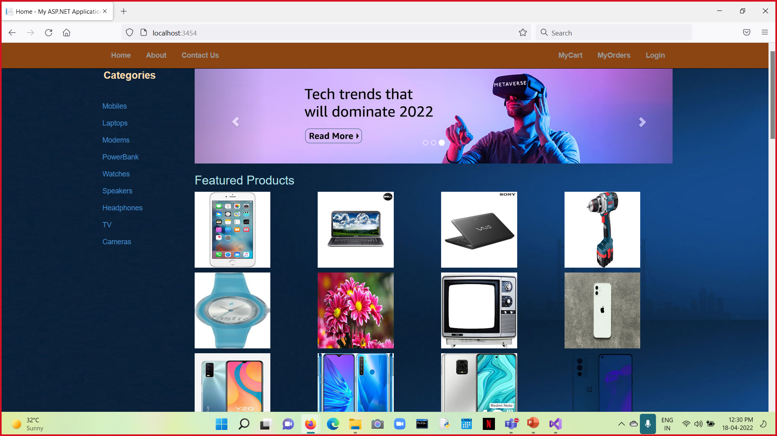

Slide 8
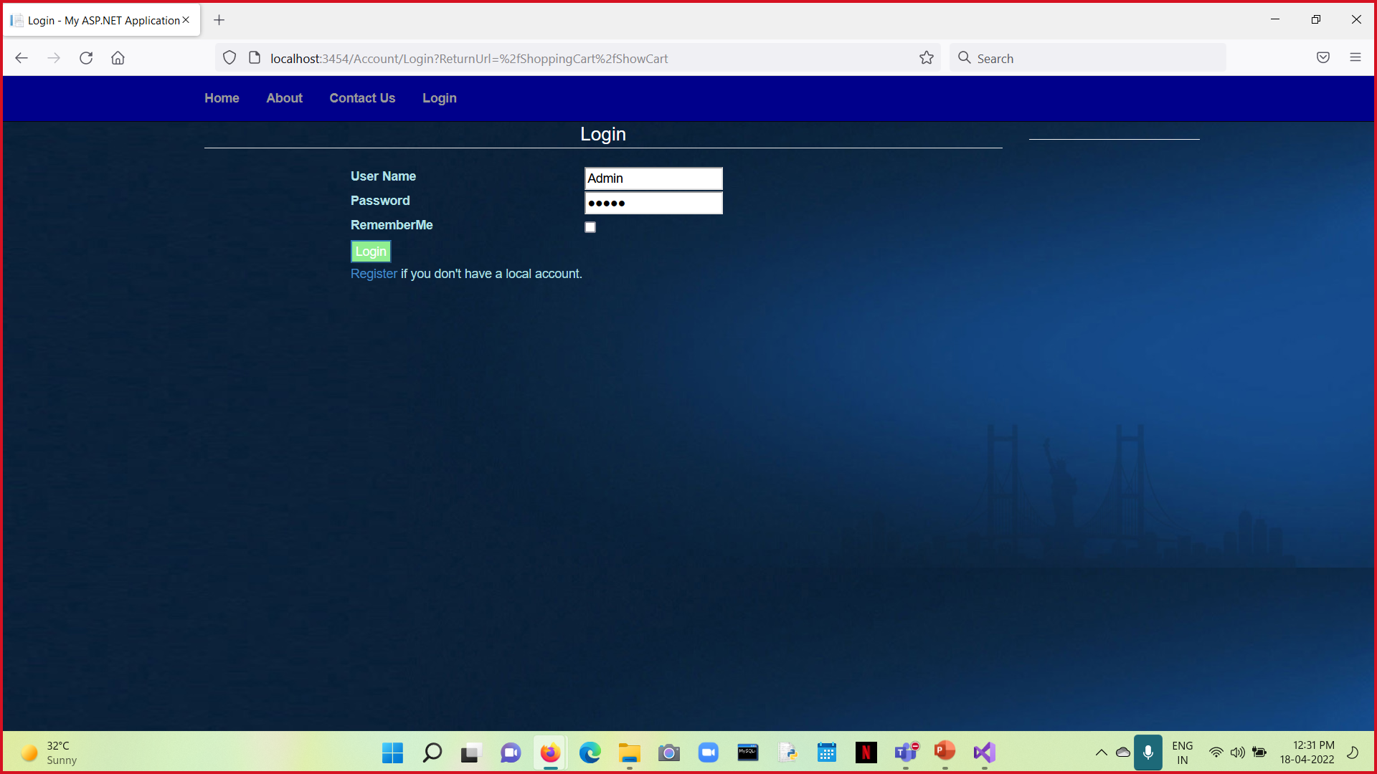

Slide 9
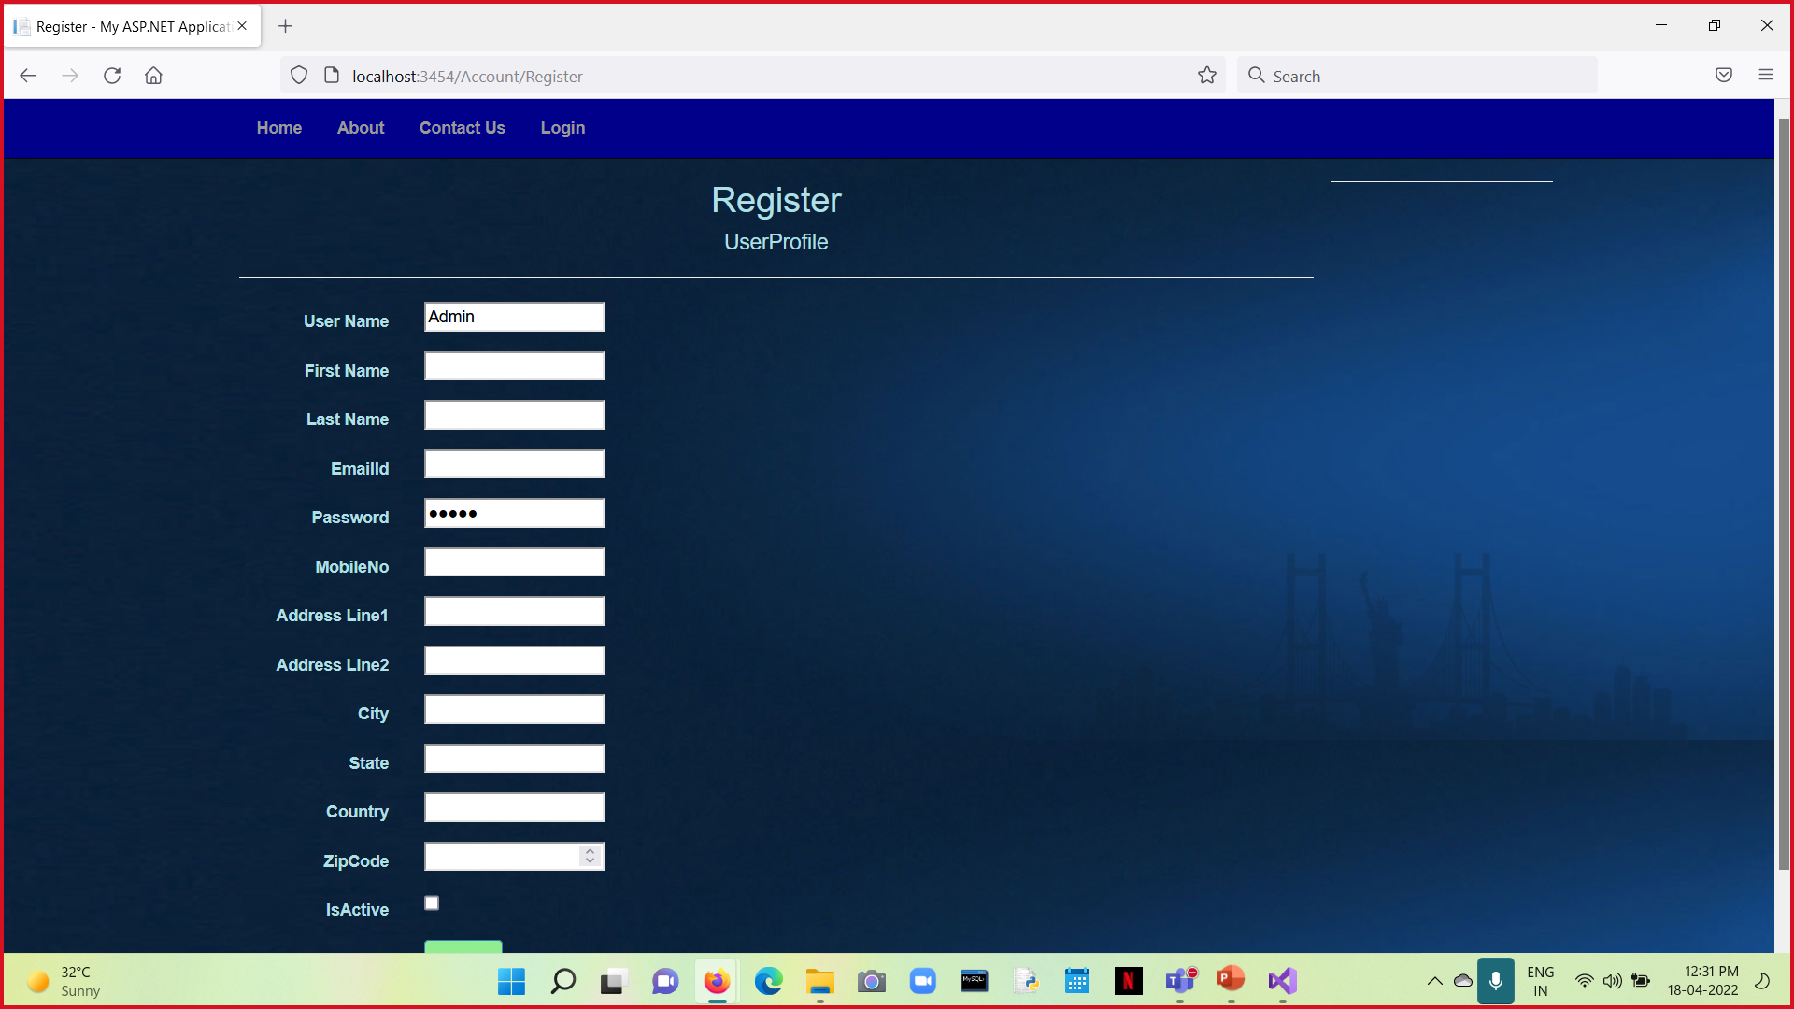

Slide 10
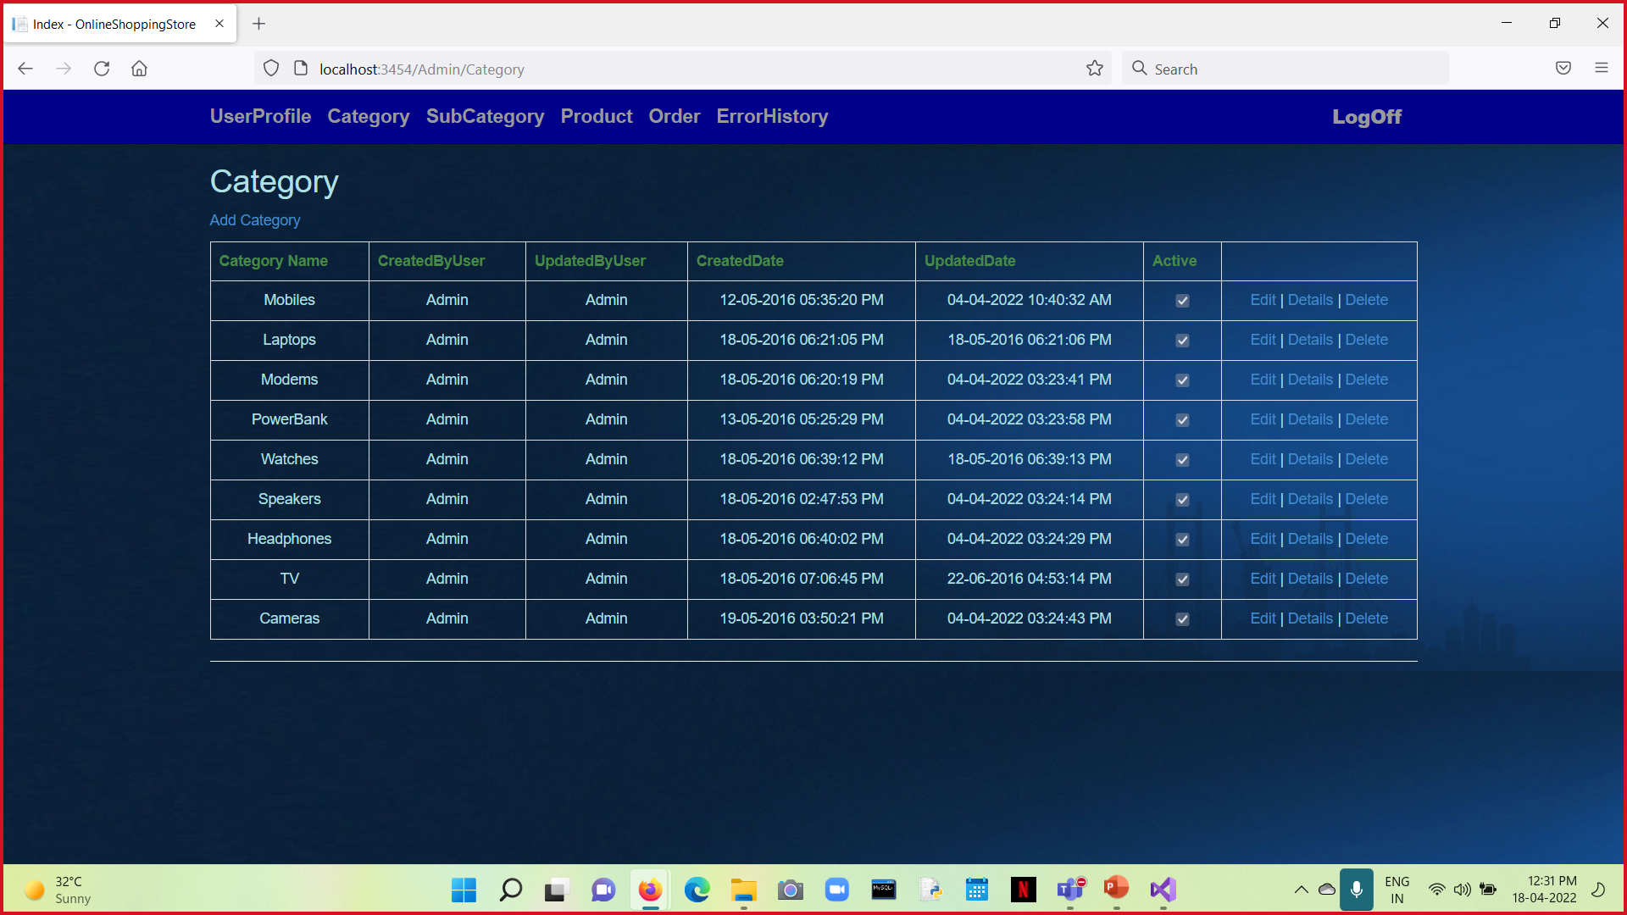

Slide 11
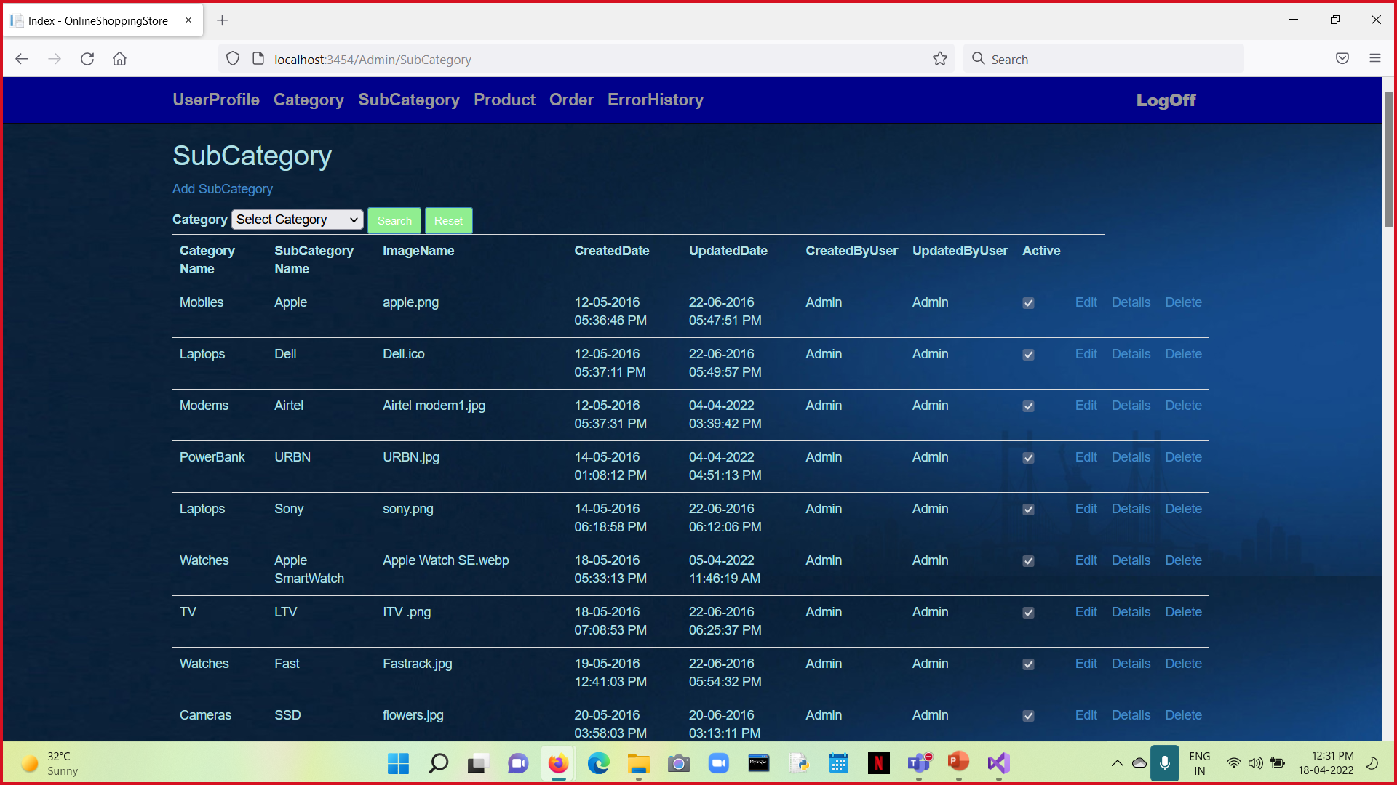

Slide 12
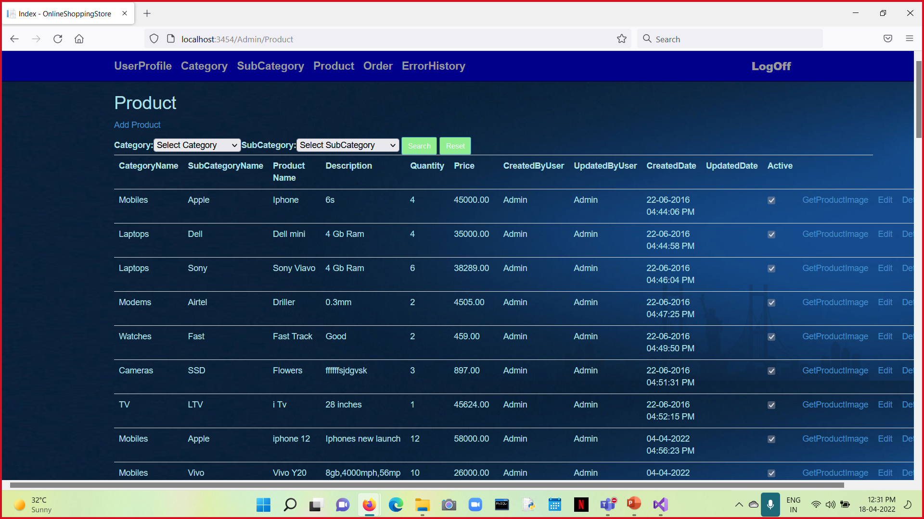

Slide 13
Thank You.

